Slide 1




MKTBA Hackathon 2024
Generative AI - Text (Case)
By Team “Insights Lab”
Team Members:
Faisal Rahman Chowdhury
Tazeen Rashid

Slide 2
01
Problem Introduction
02
Approach Overview
03
Analysis & Findings
Contents
04
Sentiment Model Demo/Results
05
Actionable Recommendations
06
Conclusion

Slide 3
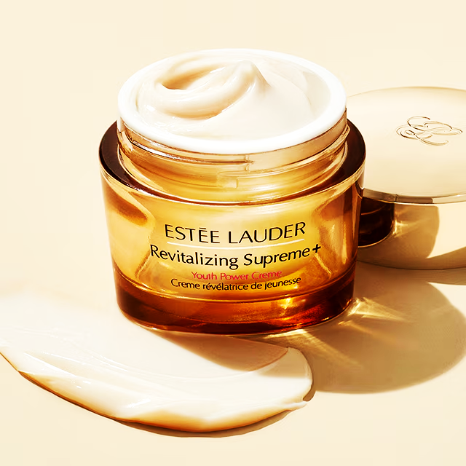
Understanding Amazon’s Business Goals in the Context of Estée Lauder Reviews
Problem Introduction
Amazon’s Objectives:
Amazon strives to be the most customer-centric company in the world. They aim to:
Provide quality product recommendations.
Ensure customer satisfaction through relevant product offerings.
Drive sales by identifying and highlighting top-rated products that align with consumer preferences.
Use Case:
In this case, we focus on the Estée Lauder Revitalizing Supreme+ Youth Power Cream. By analyzing customer feedback from 500 Amazon reviews, we can uncover key product features that resonate with customers, as well as any potential pain points.
Business Goals and KPIs:
Increased Sales: By understanding what customers like (e.g., hydration, anti-aging) or dislike (e.g., price, breakouts), Amazon can optimize recommendations to drive more sales and enhance the customer shopping experience.
Customer Satisfaction: Identify products that meet or exceed customer expectations to ensure high ratings and positive reviews
Product Positioning: With better sentiment analysis, Amazon can fine-tune product descriptions, marketing, and promotions
Approach Overview
Analysis & Findings
Sentiment Model Demo/Results
Actionable Recommendations
Conclusion
Founder
Notes:
Project Objective: Analyzing how customer reviews of products like the Estée Lauder Cream can help Amazon refine its customer experience and product offerings.
Goal for Project:
Leverage sentiment analysis and keyword ranking to provide actionable insights for Amazon’s product recommendations and Estée Lauder’s marketing strategy, helping both improve customer experience and drive sales.

Slide 4
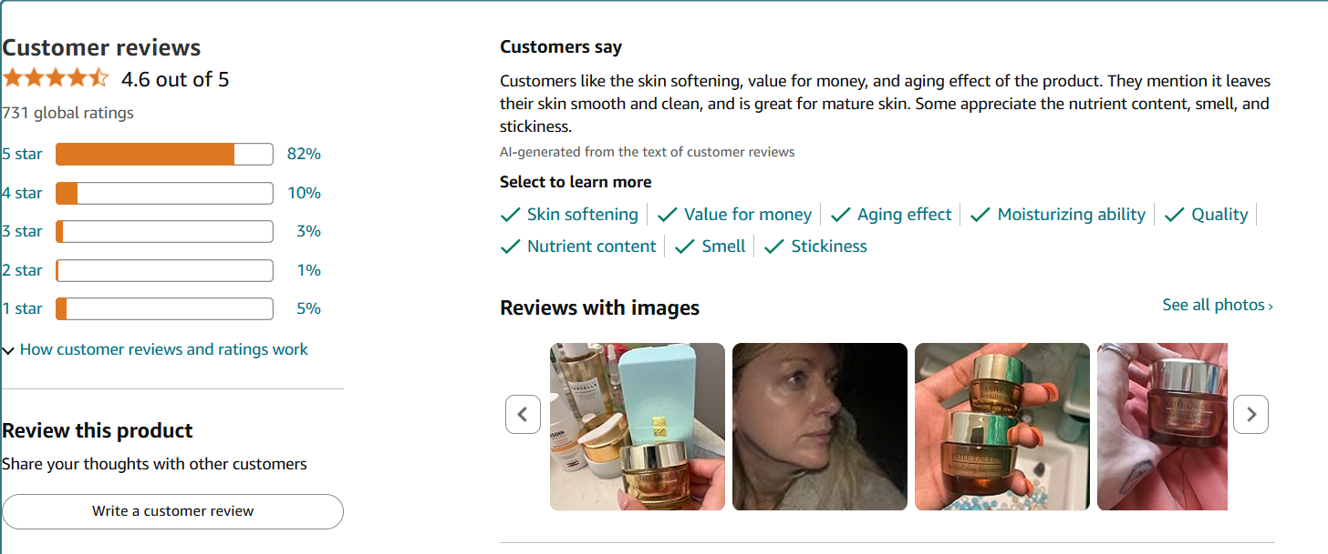
Current Model
Problem Introduction
Approach Overview
Analysis & Findings
Sentiment Model Demo/Results
Actionable Recommendations
Conclusion
Problem: There is no ranking in term of what features are important for customers – Need to have better model

Slide 5
Our Approach to Analyzing Amazon Reviews
Problem Introduction
Step 1
Data Collection:
500 Amazon reviews of Estée Lauder’s Revitalizing Supreme+ Youth Power Cream.
Approach Overview
Analysis & Findings
Step 2
Data Preprocessing:
Translating, Cleaning, tokenization, removing stopwords, and preparing data for analysis.
Sentiment Model Demo/Results
Actionable Recommendations
Techniques Used:
Step 3
TF-IDF to find frequent, impactful keywords.
Sentiment Analysis to categorize reviews into positive and negative.
Sentiment Keyword Mapping to associate sentiment with identified product features.
Random Forest for feature importance
Conclusion
Step 4
Check Model’s Performance
Confusion Matrix for Model Evaluation

Slide 6
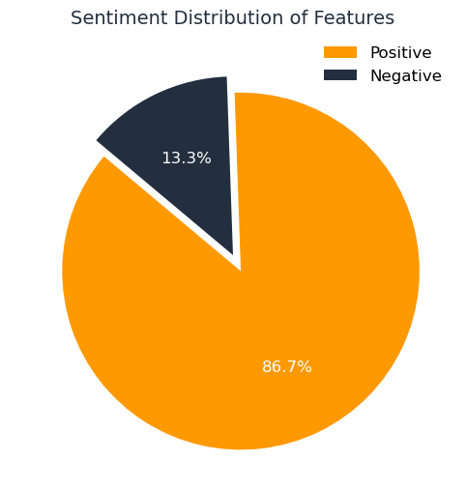
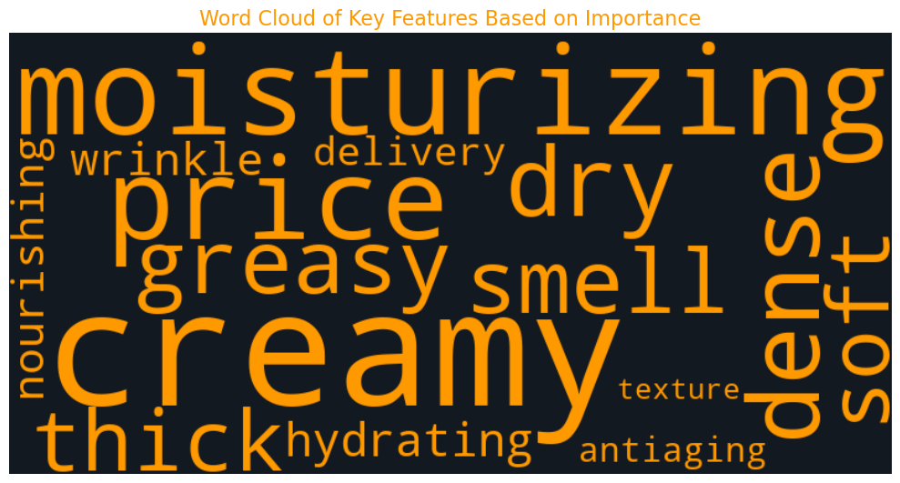
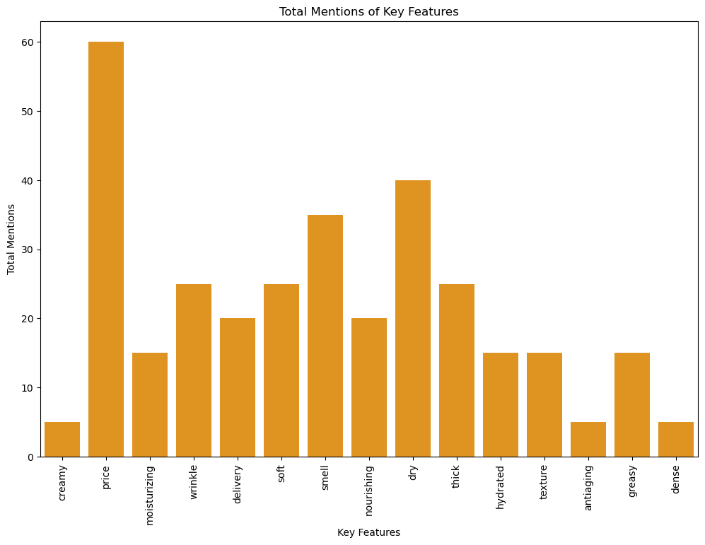

Key Insights from Sentiment Analysis & TF-IDF
Problem Introduction
Approach Overview
Analysis & Findings
Sentiment Model Demo/Results
Actionable Recommendations
Customer Sentiments:
86.7% Positive Sentiment
Discovering Key-Features from reviews
Frequency of Key Features
Conclusion

Slide 7
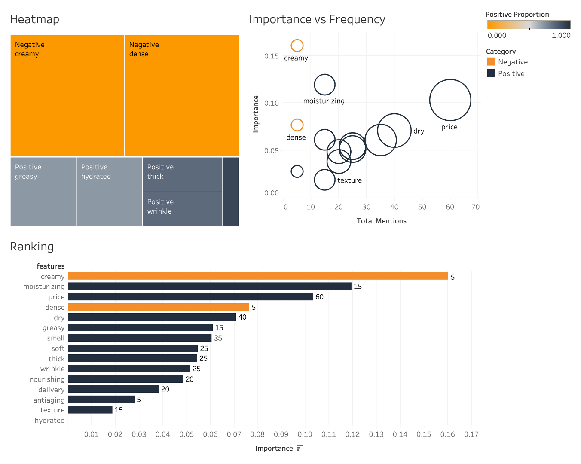
Key Insights from Random Forest & Keyword Ranking
Problem Introduction
Approach Overview
Analysis & Findings
Sentiment Model Demo/Results
Actionable Recommendations
Mapping & Ranking
Sentiment-FeaturesMapping
Features Ranking
Conclusion

Slide 8

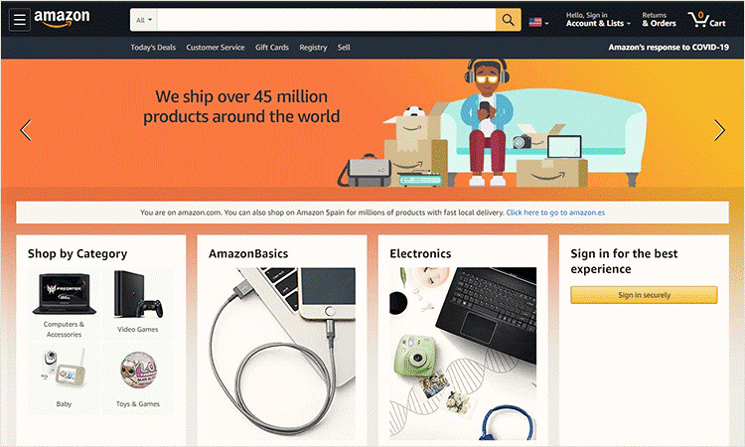
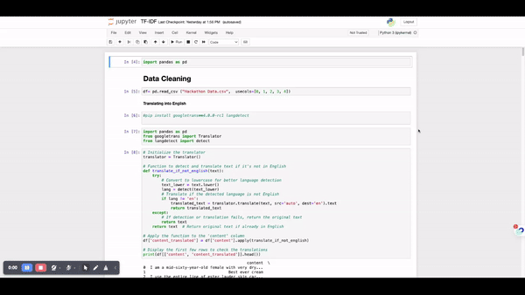

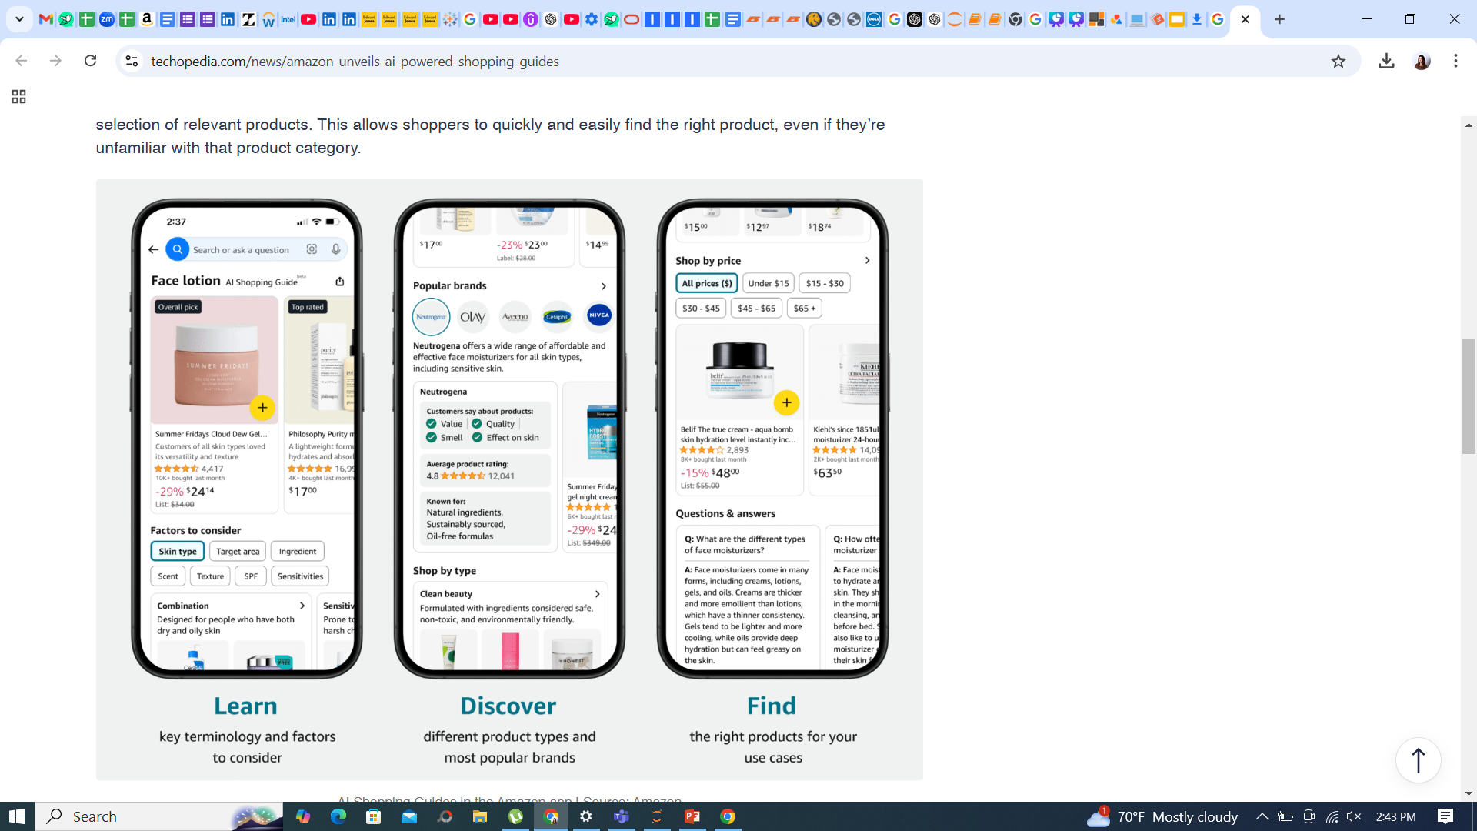

Sentiment Model Demonstration
Problem Introduction
Approach Overview
Analysis & Findings
Sentiment Model Demo/Results
Actionable Recommendations
Conclusion
Moisturizing (15)
Price (60)
Dry Skin (40)
Not thick & creamy (5)
Too dense (5)

Slide 9

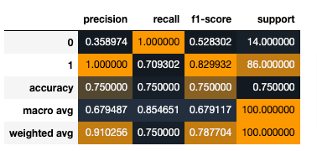
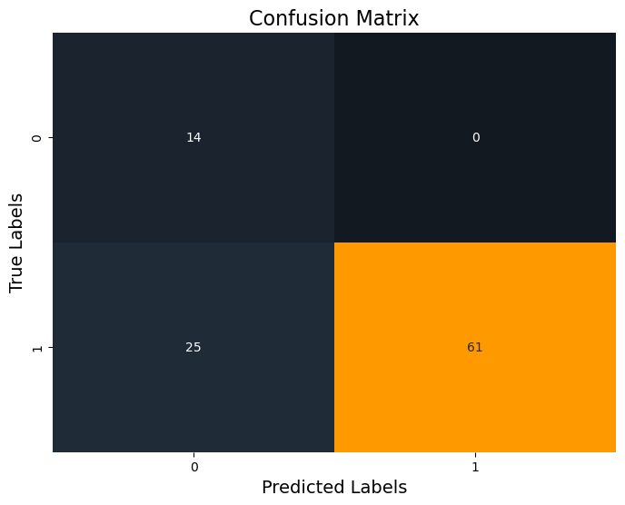
Model Performance
0.91
0.75
Precision (weighted avg)
Recall (weighted avg)
Of all instances the model predicted as negative (class 0), only 36% were actually negative. The model predicted positive (class 1) with perfect accuracy.
Every time the model encountered an actual negative review, it correctly predicted it as negative (100% recall). Of all the actual positive instances, the model correctly identified 71% of them as positive.
0.79
75%
True Positives
False Negatives
F1-Score (weighted avg)
Accuracy
The weighted averages suggest that, overall, the model performs better on the positive class (class 1) because it has high precision and good recall in this case.
The model performs well in general, with an overall accuracy of 75%, but this is driven by the strong performance in predicting the positive class.
False Positives
True Negatives
Notes:
F1-Score: The harmonic mean of precision and recall. It balances the trade-off between precision and recall.
F1-Score for Class 0: 0.53
This reflects a moderate performance. Since precision is low and recall is high (1.0), the F1 score is relatively modest.
F1-Score for Class 1: 0.83
This reflects better performance since the precision and recall are both high.
Since the positive class (class 1) has more instances (86 vs. 14), the weighted average gives more importance to its performance, which explains the higher overall precision (0.91) and reasonable recall (0.75)

Slide 10
Actionable Recommendations for Amazon Based on Review Insights
Problem Introduction
Enhance Product Recommendations:
Optimize the recommendation engine by integrating sentiment and Ranking. Provide a more dynamic and precise recommendation engine compared to traditional model.
This ranking system will ensure that Amazon’s recommendation algorithm is more aligned with customer sentiments, leading to more accurate product suggestions.
Expand Data Collection for Better Insights:
Increase Data Coverage: To enhance the accuracy and scope of your analysis, expand the dataset beyond 500 reviews by including more reviews.
Other Data Sources: In addition to reviews, integrating customer queries, ratings, and social media feedback can provide a broader picture of customer sentiment and feature preferences.
Address Customer Pain Points:
Identify the frequent complaints related to pricing and product efficacy (e.g., "too thick," "greasy"). Amazon can highlight customer reviews that address these concerns or offer more context around the product’s features.
Trial/Discount Programs: Given that price sensitivity is a common concern, Amazon could consider offering trial sizes or discounted offers for highly rated products, helping reduce the perceived risk for hesitant buyers.
Approach Overview
Analysis & Findings
Sentiment Model Demo/Results
Actionable Recommendations
Conclusion
Notes:
Optimize recommendation engine: For example, based on customer sentiment, Amazon can recommend the Estée Lauder Revitalizing Supreme+ Youth Power Cream to users who have shown interest in anti-aging or hydrating products.
Expand data: Collecting more diverse data will improve the quality of sentiment analysis and make the ranking system more robust, leading to better recommendations and insights.

Slide 11
Actionable Recommendations for Amazon Based on Review Insights
Problem Introduction
Targeted Marketing and Promotions:
Create dynamic promotions based on the ranked sentiment.
Consider bundling offers for products that frequently rank high in hydrating or anti-aging, and provide discounts or special offers to drive sales for top-rated products.
Use the ranked keywords to personalize email campaigns, showing customers products that match their sentiment profile
Customer Engagement:
Encourage more customers to leave detailed reviews that include specific feedback on features identified as high-ranking (e.g., “hydrating,” “smooth texture”). Amazon can incentivize detailed reviews with rewards, loyalty points, or access to exclusive products.
Foster a review-based feedback loop where customers who leave highly detailed reviews (especially on products with high-ranking features) are further encouraged to contribute, creating more valuable data for both Amazon and Estée Lauder.
Broader Application:
Applying the model to other products in Estée Lauder's portfolio for comprehensive brand analysis.
Approach Overview
Analysis & Findings
Sentiment Model Demo/Results
Actionable Recommendations
Conclusion
Notes:
Create dynamic promotions based on the ranked sentiment. For example, promote products with top-ranked positive features (e.g., hydration, anti-aging) to audiences who have demonstrated interest in those qualities.
Use the ranked keywords to personalize email campaigns, showing customers products that match their sentiment profile (e.g., if a customer’s reviews mention hydration or anti-aging, recommend products with similar positive attributes).

Slide 12
Problem Introduction
Approach Overview
To summarize, we’ve developed a ranking-based sentiment analysis model that can enhance Amazon’s product recommendations.
Our model leverages customer sentiment to highlight key product features that drive both positive and negative sentiments.
With actionable insights, Amazon can refine its marketing, improve product positioning, and drive higher customer satisfaction and sales.
Analysis & Findings
Sentiment Model Demo/Results
Actionable Recommendations
Conclusion

Slide 13
thanks!
If you have any questions, feel free to share them with us at fchowdhury1@leomail.tamuc.edu
trashid2@leomail.tamuc.edu

